Slide 1
Dialysis Care Quality Improvement Through Visual Interactive Analytics
Jay Wang, D.Sc., MBA, PMP
November 7, 2019

Slide 2
The National Impact of End-Stage-Renal-Disease (ESRD)
650K ESRD Patients
7,000 Dialysis Facilities
$33 Billion CMS Annual Expenditure
1% Medicare Beneficiaries Consume 7% Medicare Expenses
Notes:
Other work, prior work, done at MITRE or elsewhere. Things you’re building on. Things that have been tried, and failed, that you are informed by. A Background section properly executed frames the technical opportunity that converges with the operational problem. The Background section situates your proposal in the continuum of science and engineering. It should show you are aware of the state of the art in this research area and will not be repeating others’ work.

Slide 3
Achieve Triple Aims Through Health Data Science
Triple Aims
Improve Patient Experience
Improve Population Health
Reduce Cost of Care
Improve Patient experience
Monitor the quality of care
Compare the quality of facilities
Improve Population health
Discover Social Determinants of Health (SDoH)
Inform clinical and policy decision making
Reduce Cost of Care
Increase facilities’ operational efficiency
Identify risk factors affecting outcomes & cost
Notes:
This is the elevator speech for your research topic (takes lots of practice to perfect): a concise recapitulation of your objective in light of the Problem, and a quick, high-level introduction to your Technical Approach. The whole thing should typically be over in about a minute and a half. If you take much longer, you begin to eat into your Technical Approach time. It really should be set up for that, rather than redundant with it.
Note: you don’t HAVE to title this “Idea”. If your idea can be summed up in a phrase or short sentence, you could use that instead, e.g., “Flying Cars Relieve Airport Congestion” (in that case, add a nice picture…)

Slide 4
The Current State & Challenges
Outdated Data
Static Formats
Poor Usability
Yearly Reports
Overlapping information
Inconsistency in data
Two-year behind
Traditional Formats
PDF
Excel
Web pages
Poor Usability
Lack of visualization
Lack of interactivity
Lack of self-service

Slide 5
The Future State – Dialysis Dashboard for All
Dialysis Dashboard
Real-time
Visual
Interactive
For All
Patients
Providers
Policymakers
Keep Data Consistent and Current
If data is the new oil, let’s keep it flow
Provide Self-Service Analytics
Place data at the fingertips of stakeholders
Support Evidence-Based Healthcare
Let data inform clinical care and policy making

Slide 6
Key Features of The Dialysis Dashboard
Multiple Data Sources
Cleansed
Consolidated
Controlled
Engaging visualizations
Descriptive
Predictive
Prescriptive
Multiple Stakeholders
Patients
Providers
Policymakers
Dialysis Dashboard
Engaging Visualizations
Multiple Data Sources
Multiple Stakeholders

Slide 7
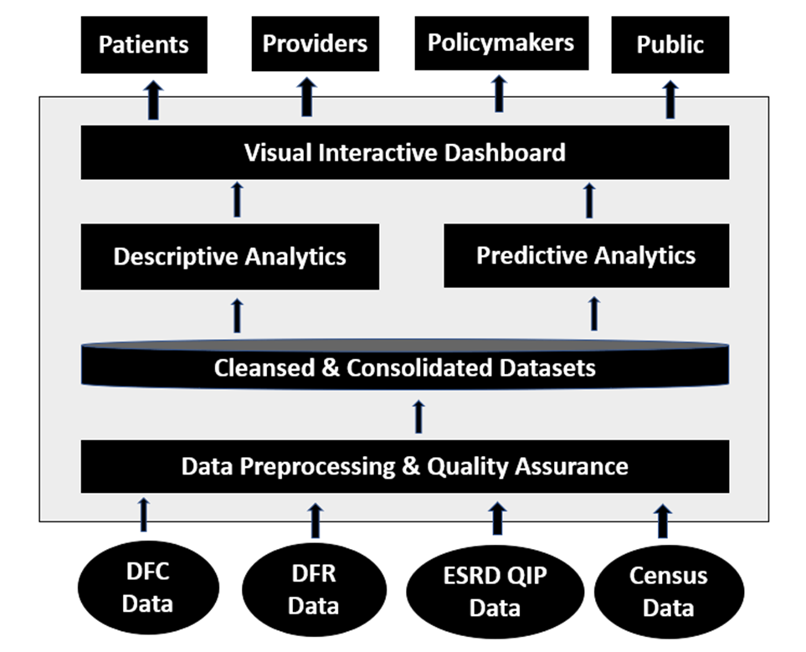
Proof of Concept (POC) – Multi-Tier Design

Slide 8
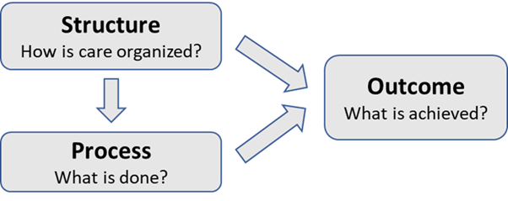
POC – Apply Donabedian Quality Model

Slide 9
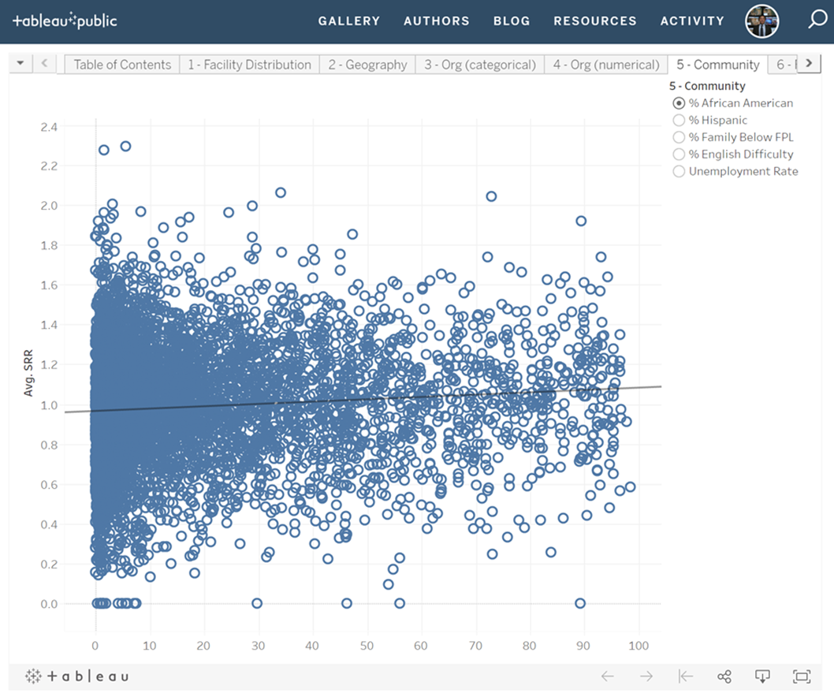
Finding - Strong Evidence of SDoH
https://public.tableau.com/profile/jaywang

Slide 10
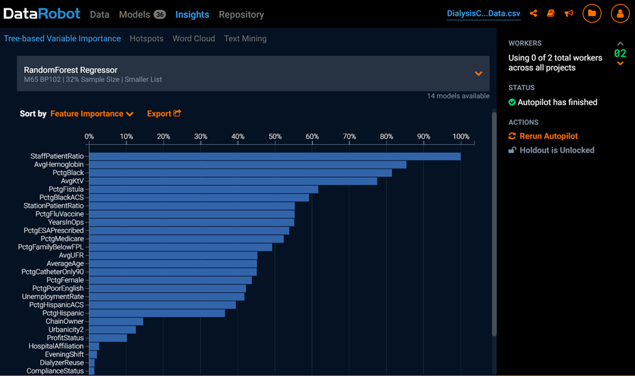
Finding - Staffing Level Is The Most Impactful Factor

Slide 11


